Slide 1
Employee performance Analysis using exCEL
Name : k. Kaviya
Register no : 312214271
Department : financial accounting
College :ST. Thomas college art & science

Slide 2
Project title :
Employee performance analysis using excel

Slide 3
Manager and employee review job description and update as needed.
Dataset Description
Employee submits written Self-Assessment to manager.
Manager solicits multi-rater feedback from colleagues, customers, and direct reports.
Manager documents performance in written Annual Performance Review.

Slide 4
Agenda
Employee self-assessment. ...
Feedback from colleagues. ..
Manager's assessment
Discussion
Automate feedback collection
Set up approvals

Slide 5
Problem statement
To write a problem statement on employee performance, you need to identify the specific area of performance that is problematic, such as low productivity, high absenteeism, or poor quality of work.

Slide 6
Project overview
Project performance is a measure used to assess the success or failure of a project. It encompasses multiple aspects, such as meeting deadlines, staying within budget, adhering to project plans, and delivering quality results that meet or exceed expectations.

Slide 7
Who are The end users
people who use a product or service on a regular basis, and their performance can be monitored in a number of ways
Satisfaction levels
Application performance monitoring
Real user monitoring

Slide 8
Our solution and its value proposition in employee performance
A strong Employee Value Proposition does more than attract and keep talent—it's a motivational force
Compensation. Candidates and employees care about compensation, but it's just not the only factor when making an employment decision
Total rewards package
Career advancement opportunities
Contribution to the world

Slide 9
data collection
Collecting performance data is the process of gathering metrics and logs that provide information about the performance of a workload. This data includes numerical values, which are known as metrics. Metrics describe the state of the system at a particular point in time

Slide 10
features collection
performance features indicate how well a participant completed the assigned task; some examples of these features are the task completion time, wrong turns, and collision counts.
enables you to collect data about operational events in Unified Service Desk client application to log files, which is used to identify and troubleshoot

Slide 11
INCENTIVE PERFORMANCE CALCULERIN
Incentive Amount = (Actual Performance - Threshold) × Incentive Rate.
Actual performance: This is the performance achieved by the individual or team during the defined period.
Traditionally, the performance factor is calculated on a time basis
multiplying the performance metric by the bonus percentage.
Performance = Capacity x Commitment
incentive programs can increase employee performance by up to 44%

Slide 12
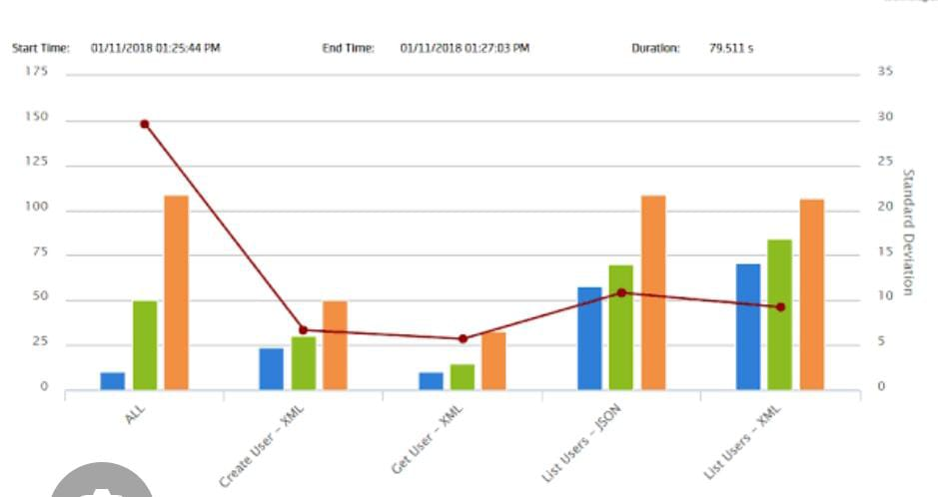
Results

Slide 13
conclusion
In conclusion, employee performance management is an essential part of any successful organization. It provides the necessary feedback to develop employees, encourage growth, and align goals with company objectives.

